Slide 1

Notes:
hi I am christine, and this is my team -, -, and -. We would like to present our design for the ‘useless invention’ design challenge: the selfie paradox

Slide 2


SELFIE PARADOX?
A SELFIE STICK:
Notes:
So what is the selfie paradox? What does it do? Before we tell you that,

Slide 3
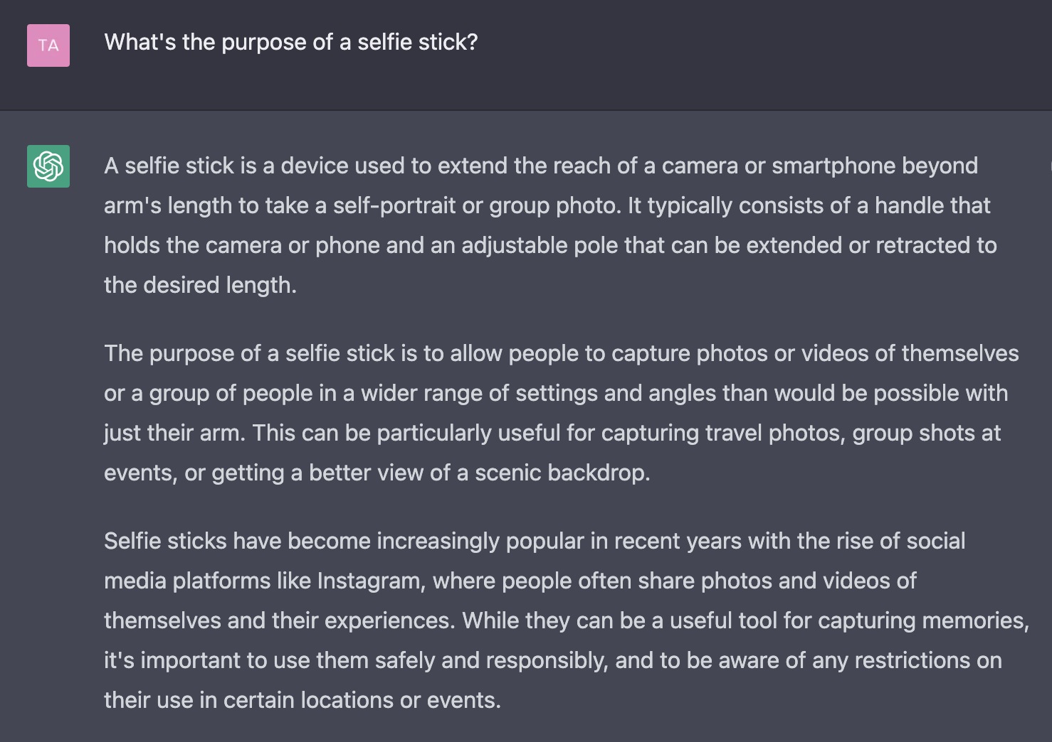
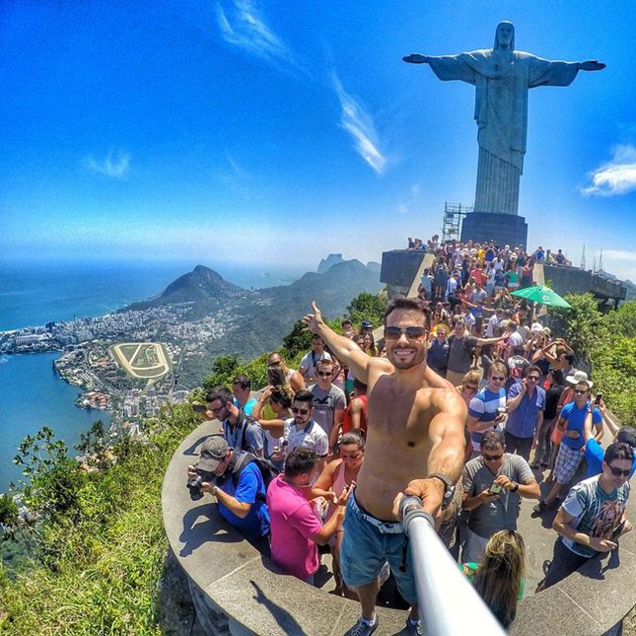
SELFIE PARADOX?
What’s it’s purpose?
Notes:
we asked chatgpt what the purpose of a selfie stick is, and it said that it is to capture an image with a wider range like this guy in the picture did.

Slide 4





SELFIE PARADOX
A selfie stick
Notes:
Now we’ve reviewed the background, it is time for our selfie paradox. The selfie paradox is a selfie stick with a camera app that adjusts the zoom ratio depending on the distance the camera moved so that the subject stays the same ratio. In more detail, when the subject is close, the camera zooms out, and when the subject is far, it zooms in.

Slide 5


PLAN
Input distance with ultrasonic sensor
Transfer input to HDK8450 via bluetooth
Depending on the input distance, alter zoom ratio such that:
Further distance (high value input) => Higher zoom ratio
USELESS!
Notes:
So our plan to design this is #1, obtain the distance of the user and the camera with an ultrasonic sensor.
#2, transfer the data to our HDK 8450 device with bluetooth
#3, Depending on how the distance changes, alter the zoom ratio so that the movement of moving it is useless.

Slide 6
OUR DESIGN

Slide 7

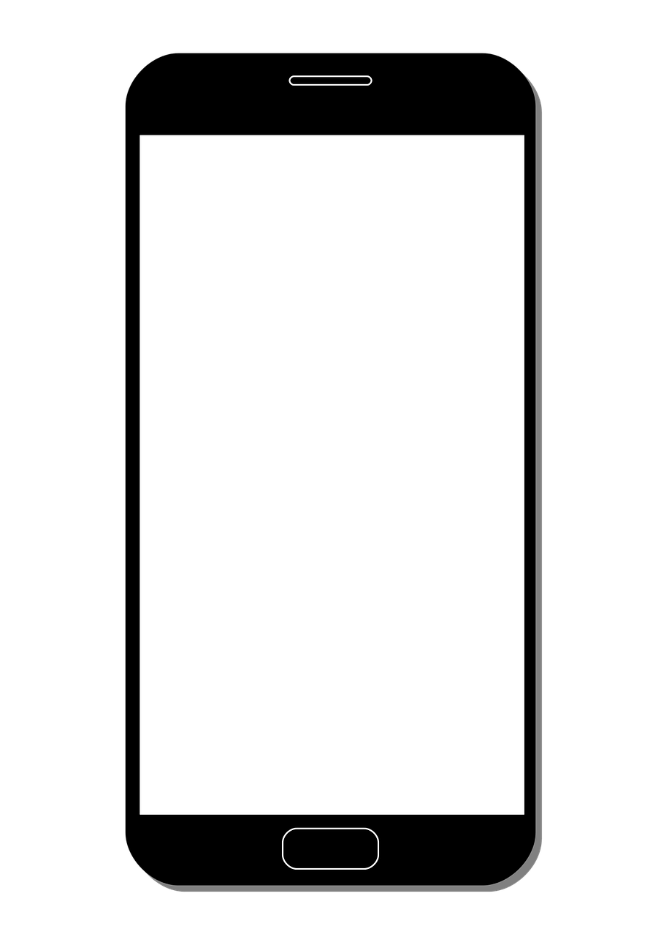
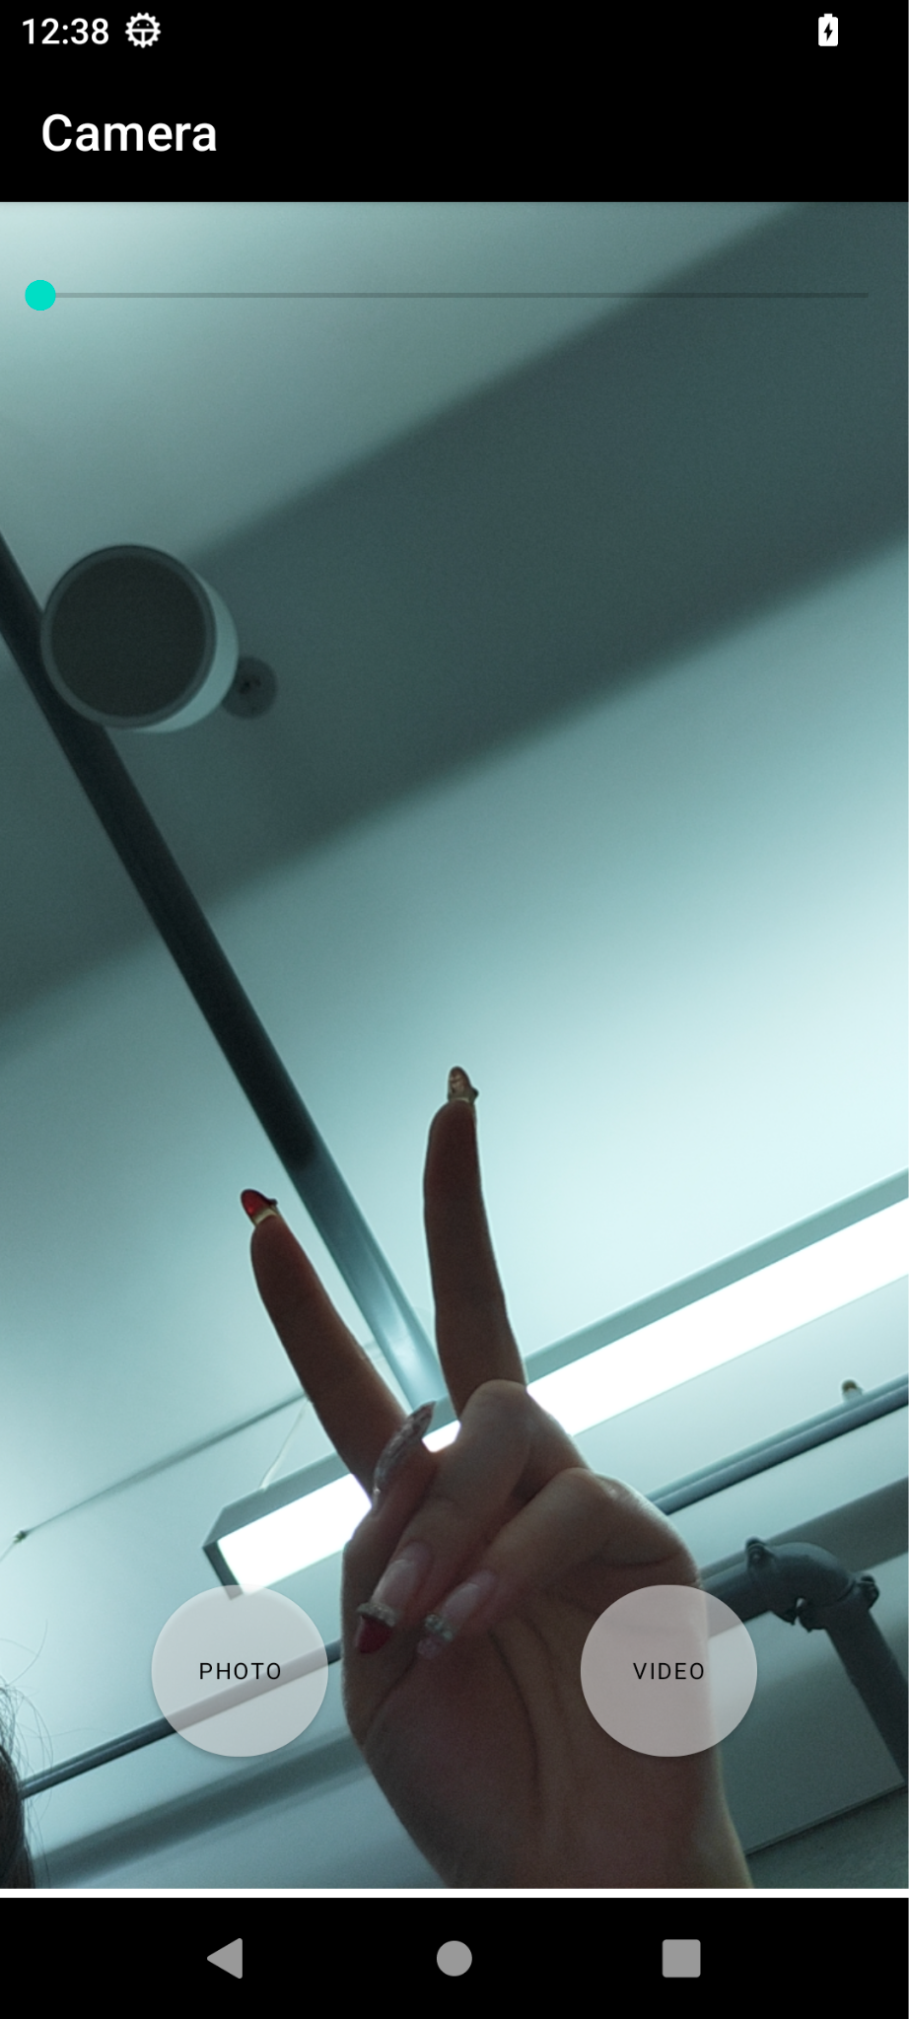
FRONTEND
Straightforward/minimalistic user interface written in xml file
Buttons to capture image, record video, and stop video recording
Slider for zoom ratio
Notes:
for the frontend, we have a camera app on this android device that we were able to build. the buttons are incredibly straightforward and we have a slider for the zoom function

Slide 8
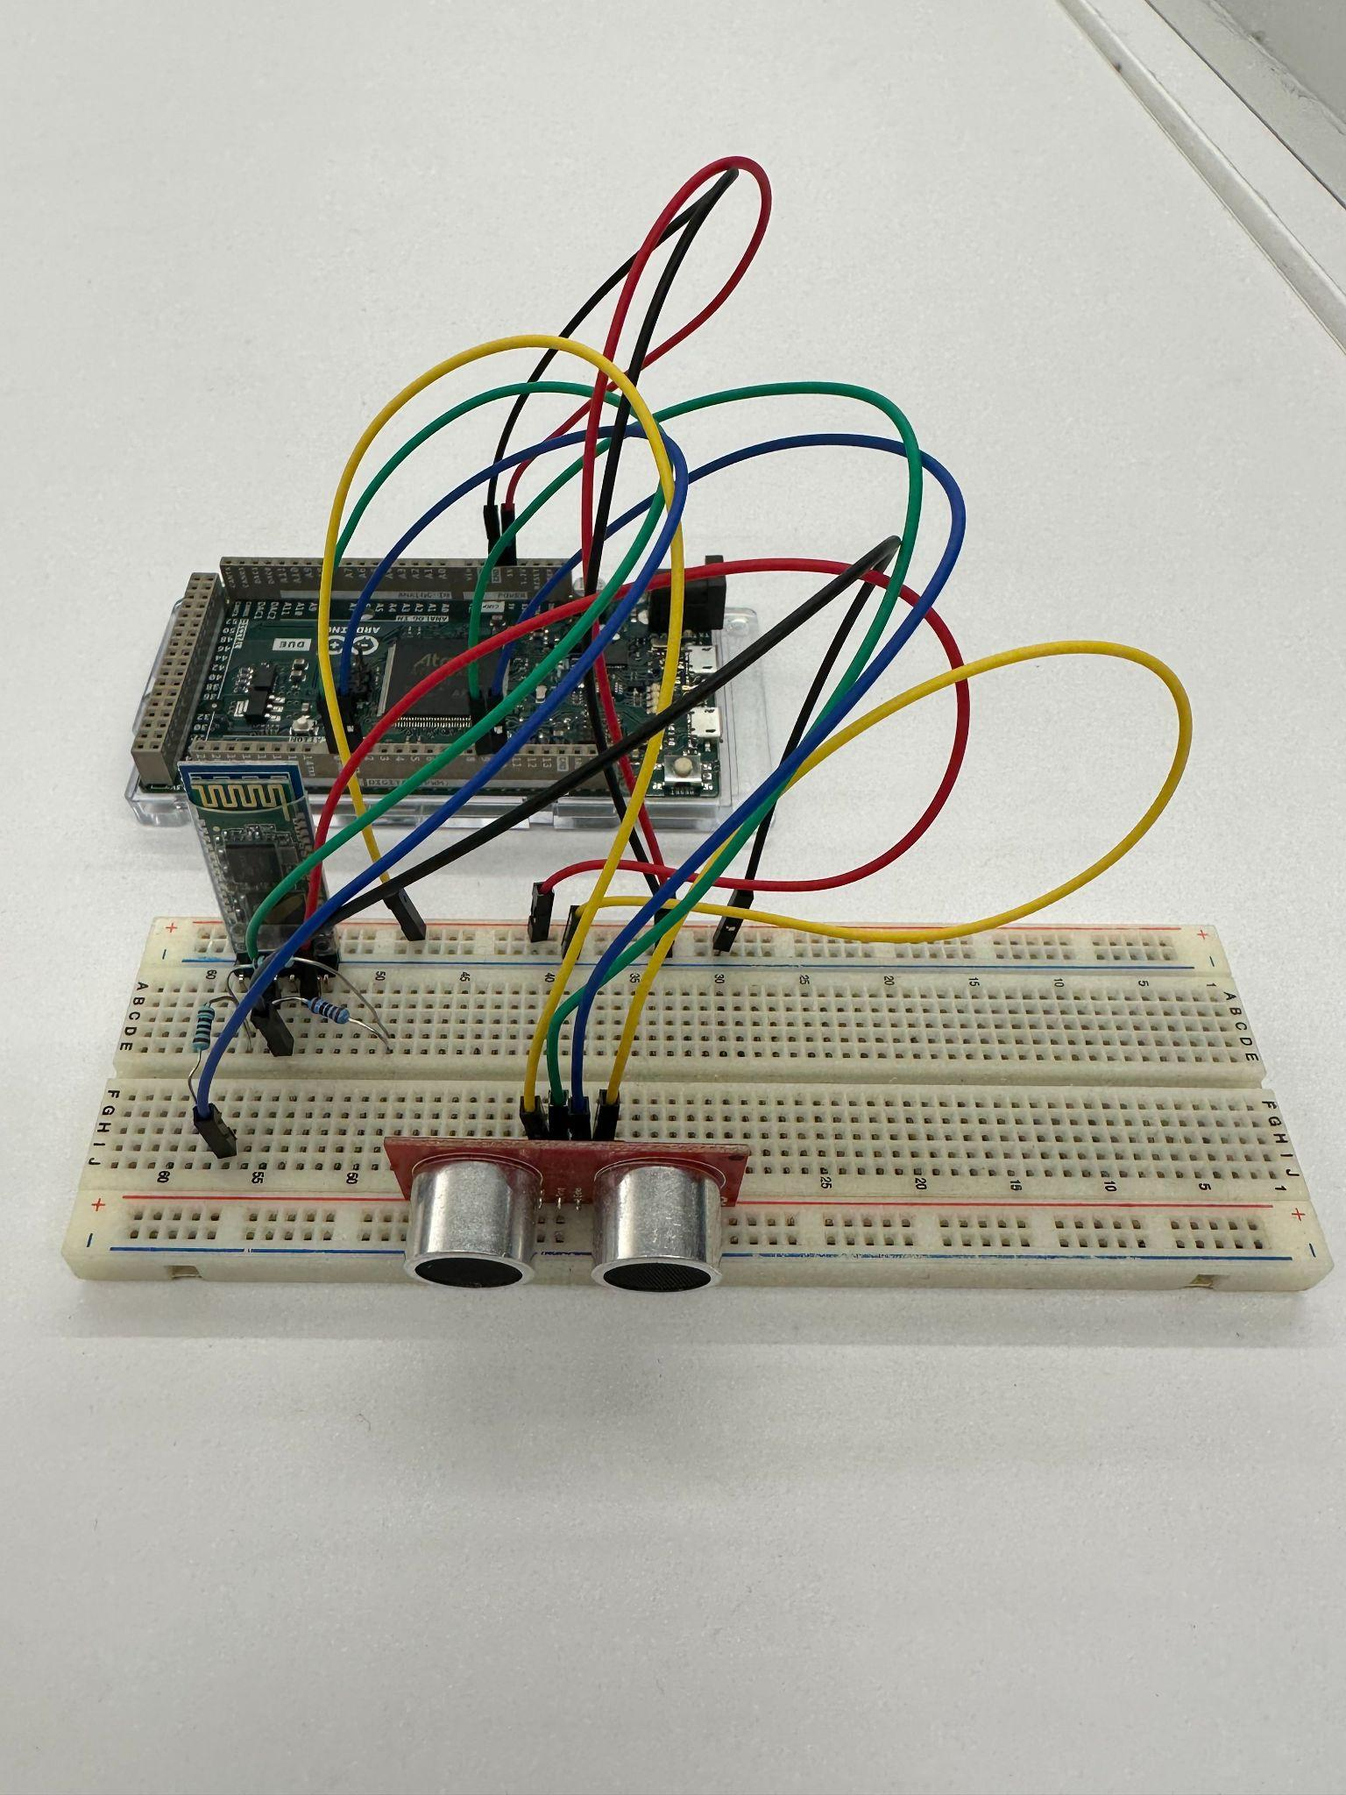
HARDWARE
Used the ultrasonic sensor to detect the distance to a target
Connected it to Arduino with HC-05 Serial Bluetooth Module to put bluetooth in use
Attached ultrasonic sensor close to the camera
Sensor senses the distance to the person taking the selfie
Notes:
on the other hand, we also made sure to use our hardware components by choosing the ultrasonic sensor to measure how far away something is. we connected this to the arduino with the HC-05 Serial Bluetooth Module so that we can connect it to the hdk device

Slide 9
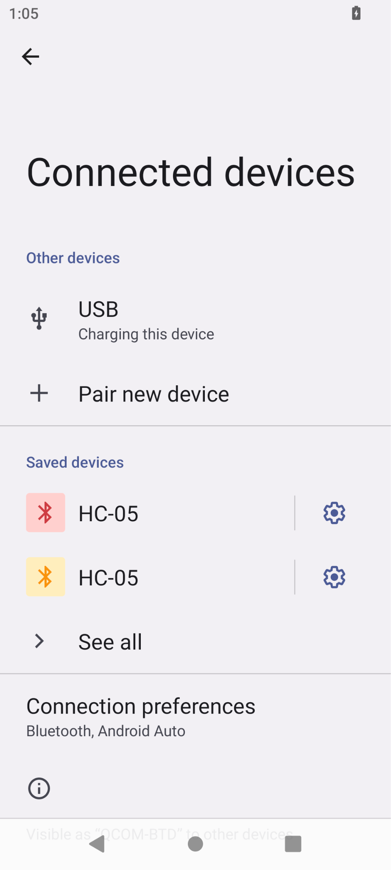

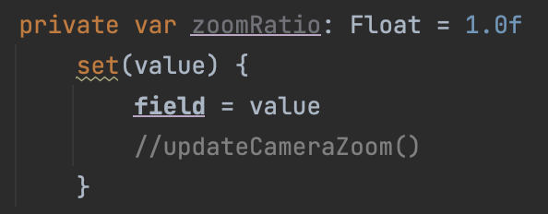

BACKEND
Developed functions for image capture, video recording, and ZOOMing via android studio putting HDK8450 in to use
Linked zoom ratio variable to distance inputted through ultrasonic sensor through bluetooth connection
The further the selfie stick is extended, the closer the camera zooms in
ATTEMPTED!
Notes:
Now for our backend, we had high hopes. as seen before, we were able to develop the camera app via android studio including the zoom function. Then, we wanted to link the zoom ratio with the input value through bluetooth. We had the variable called zoomRatio ready to get updated based on the detected input. However, we could not get the devices to connect properly within time. (dont elaborate too much on the bluetooth challenge pls that’s for next slide)

Slide 10
CHALLENGES
Main challenge: Bluetooth connection
Could not connect HDK device with the arduino via bluetooth
Did not allow us to use the input from the sensor
Could not alter zoom ratio accordingly
Notes:
So as brandon just mentioned, our main challenge was connecting the HDK device and the arduino using bluetooth.
We suffered in keeping the two connected, making it very hard for us to use the distance we got from the ultrasonic sensor as an input to alter the zoom ratio.

Slide 11
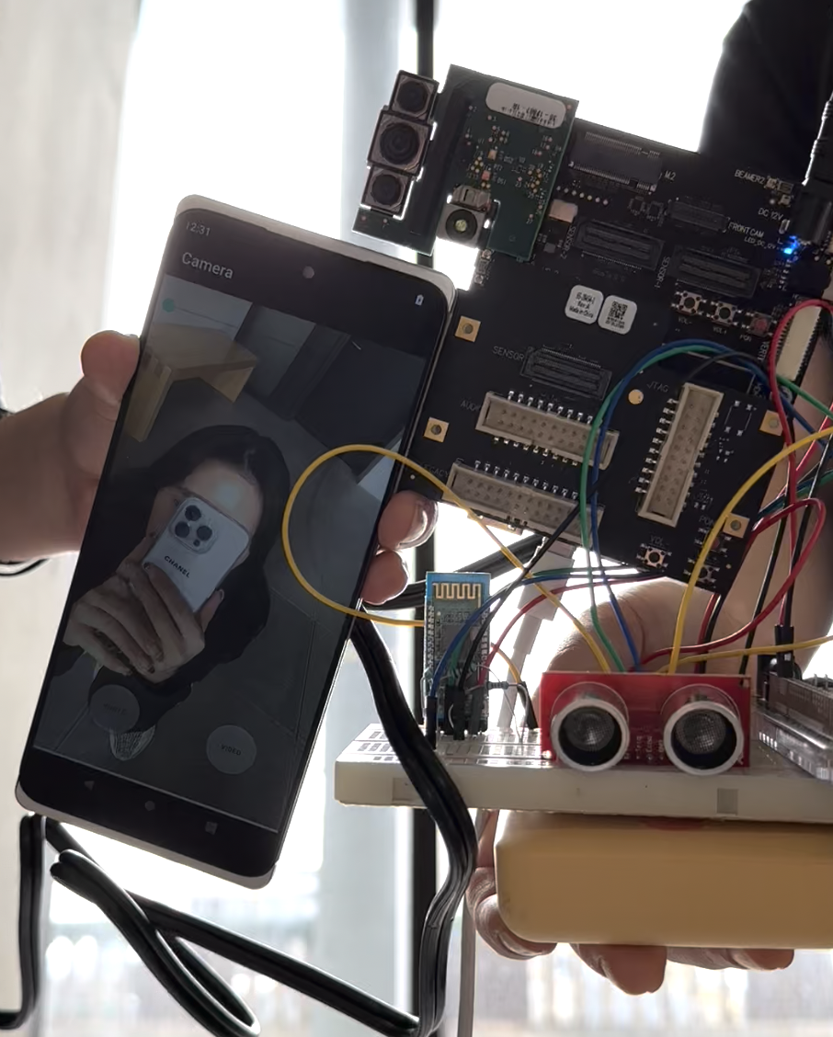
PHYSICAL PROTOTYPE
Mimicked selfie stick mechanism by moving the HDK device + sensor in a linear fashion
Demonstrated how the final product would function by zooming in as the physical device moved further from target peron (the one in the selfie)
Notes:
Therefore, even though we couldn’t get a finalized product that seamlessly functions as we wished,
we were able to put together a physical prototype demonstrating how we expected our “invention” to work out as well as the feasibility of the most significant parts.
We first mimicked the selfie stick mechanism by just walking back linearly. (cuz how to get that to work is pre trivial)
During that, we controlled the zoom ratio accordingly so that the more distance the ultrasonic sensor detected, the more zoomed in the camera got.
Here’s a very short demonstration video on how pointless extending the distance is because the contents of the frame remain the same.

Slide 12
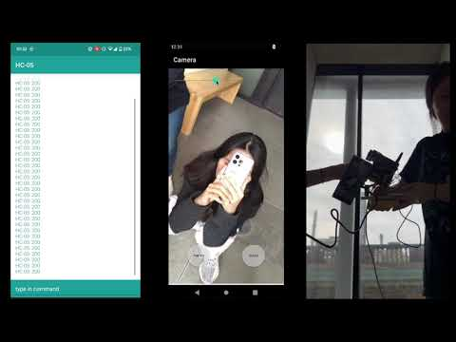
DEMONSTRATION
Notes:
Here’s a very short demonstration video on how pointless extending the distance is because the contents of the frame remain the same.

Slide 13
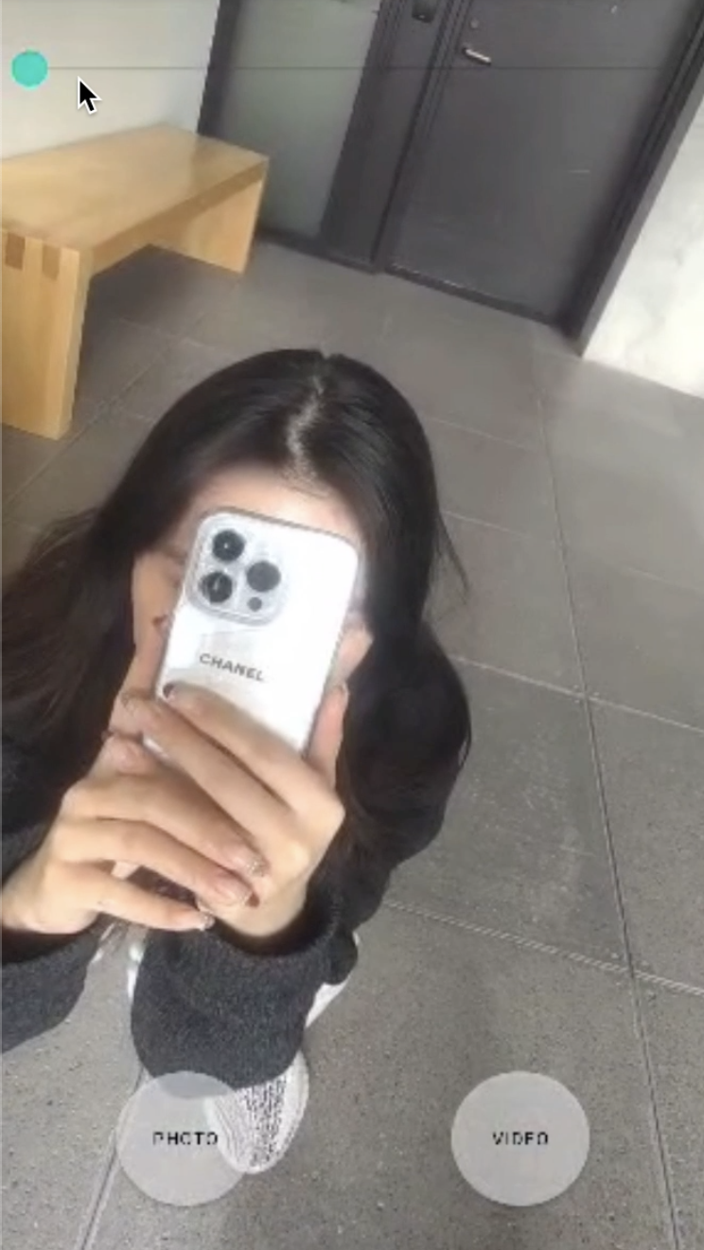
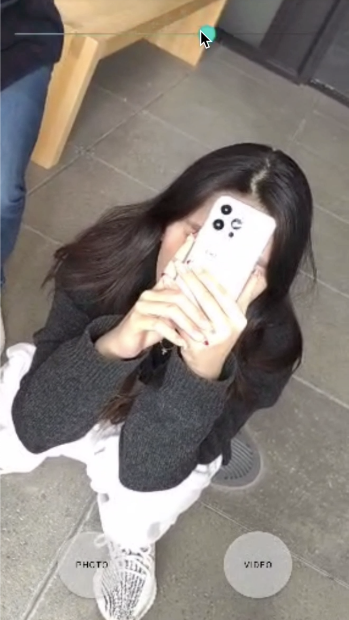
DEMONSTRATION
1m away from sensor
1.5m away from sensor
Notes:
so again, here’s a side by side comparison for the subject being a meter away from the sensor and 1.5meters away. They are pretty much showing the same thing

Slide 14
WHY US?
Put the Snapdragon 8450 processor into use by building an android camera app from scratch
Our invention is VERY useless…
Integrates multiple hardware systems
High level implementation of both hardware and software development in tandem
Notes:
Why us? We put a lot of effort to put the snapdragon 8450 processor into use by building an android camera app, especially with kotlin and XML. As we mentioned at the beginning of this presentation, this selfie stick is literally useless. Lastly, we integrated multiple hardware systems and served high-level implementation of both hardware and software development.

Slide 15
FUTURE IMPROVEMENTS
#1 Priority: Get BLUETOOTH connection between HDK8450 and Arduino to work
Clean up the hardware (actually connect it to a selfie stick) + securely connect device with sensor
Notes:
We had decided to put getting a Bluetooth connection between HDK8450 and Arduino working as the first priority to improve our project feature. And also, clean up the hardware parts, for example, making them actually combine with the selfie stick and securely connect the device with the sensor to measure the distance between the subject and device more precisely.

Slide 16
REFERENCES
Android CameraX Samples. (n.d.). GitHub. Retrieved from https://github.com/android/camera-samples.
Camera Samples. (n.d.). GitHub. Retrieved from https://github.com/Pinkal7600/camera-samples.
Android Developers. (n.d.). Retrieved February 19, 2023, from https://developer.android.com.

Slide 17


Slide 18
MakeUofT 2023
Design Challenge: Useless Invention
Selfie Paradox
Brandon Bounsophinh, Jiwon Choi, Christine Jeon, Tabitha Kim

Slide 19




SELFIE PARADOX?
A selfie stick

Slide 20
PLAN
Input distance with ultrasonic sensor
Transfer the input to HDK8450 with bluetooth
Device controls the zoom ratio by the input value: As the distance value increases, the camera zooms in As value decreases, camera zooms out, making the movement of the camera useless

Slide 21
DESIGN…???? MAJOR MATERIALS..?
Frontend
Qualcomm HDK8450
Backend
Android Studio
Hardware
Arduino DUE kit (HC-05 Serial Bluetooth Module)
Ultrasonic sensor

Slide 22
DESIGN PROCESS
Notes:
ultrasonic sensor
outlier values that are over large
decided to use mean values and mean range to eliminate outliers to exclude faulty readings

Slide 23
FRONTEND
Straightforward/minimalistic user interface
Buttons to capture image, record video, and stop video recording
Slider for zoom ratio

Slide 24
BACKEND
Developed android camera app using android studio
Straightforward program that captures images, takes videos, and ZOOMS
Linked zoom ratio variable to distance inputted through ultrasonic sensor
The further the selfie stick is extended, the closer the camera zooms in

Slide 25
HARDWARE
Connected ultrasonic sensor close to the camera
Sensor senses the distance to the person taking the selfie
Prototype:
Mimicked the selfie stick mechanism by moving the device+sensor further away from target person
Bluetooth to connect Android device with the sensor

Slide 26
DEMONSTRATION

Slide 27
Design Name
pixel puzzle
pixel paradox
selfie paradox
capture chaos
zoom outta luck

Slide 28
Future Developments

Slide 29
References

Slide 30
THANK YOU :)

Slide 31
set max dist. avoid outliers (0, +)
int i = 0
int array[9] = 0
while()
get new value
if value < 1:
value = 1
else if value > 200:
value = 200
calculate mean with saved prev vals
if (mean*0.5 < value < mean*1.5):
output value
else // if value is outside of range
pass
save value
i++
if i > 9:
i = 0

